Slide 1

ROUND ROBIN CQI BASED CELLULAR NETWORK
Performance evaluation of a RR cqi based cellular network
Antonio Le Caldare, Vincenzo Consales, Vincent della Corte - PECSN
1

Slide 2
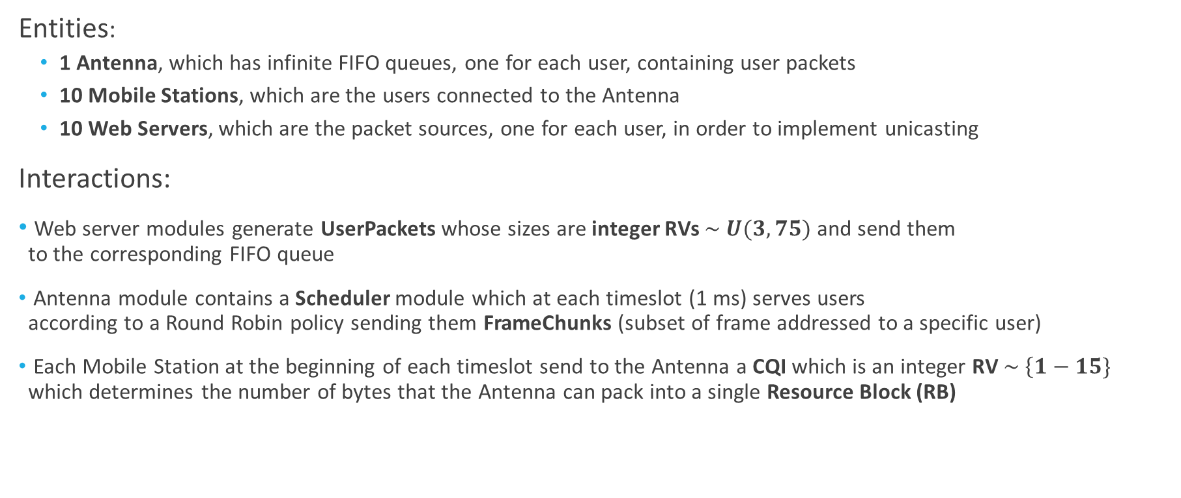
Cellular Network: Model of the System (1/2)
Entities:
1 Antenna, which has infinite FIFO queues, one for each user, containing user packets
10 Mobile Stations, which are the users connected to the Antenna
10 Web Servers, which are the packet sources, one for each user, in order to implement unicasting
Interactions:
Web server modules generate UserPackets whose sizes are integer RVs $\sim U(3, 75)$ and send them to the corresponding FIFO queue
Antenna module contains a Scheduler module which at each timeslot (1 ms) serves users according to a Round Robin policy sending them FrameChunks (subset of frame addressed to a specific user)
Each Mobile Station at the beginning of each timeslot send to the Antenna a CQI which is an integer RV $\sim \left\{1−15\}\right.$ which determines the number of bytes that the Antenna can pack into a single Resource Block (RB)
Antonio Le Caldare, Vincenzo Consales, Vincent della Corte - PECSN
2

Slide 3
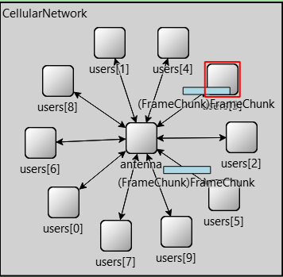
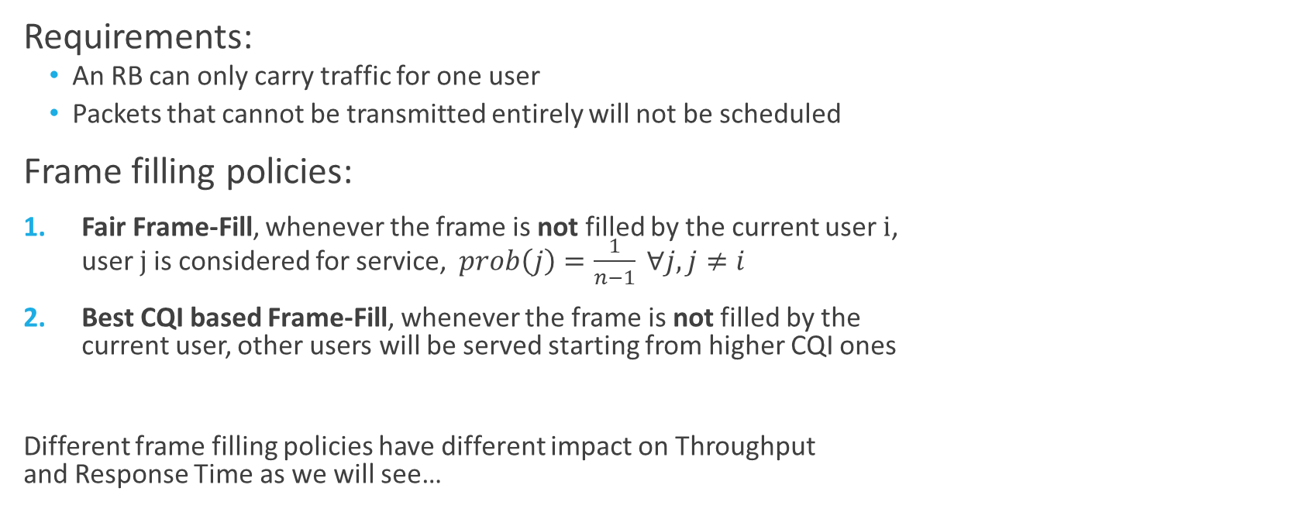
Cellular Network: Model of the System (2/2)
Requirements:
An RB can only carry traffic for one user
Packets that cannot be transmitted entirely will not be scheduled
Frame filling policies:
Fair Frame-Fill, whenever the frame is not filled by the current user i, user j is considered for service, $prob\left(j\right)=\frac{1}{n−1} ∀j, j≠i$
Best CQI based Frame-Fill, whenever the frame is not filled by the current user, other users will be served starting from higher CQI ones
Different frame filling policies have different impact on Throughput and Response Time as we will see…
Antonio Le Caldare, Vincenzo Consales, Vincent della Corte - PECSN
3

Slide 4
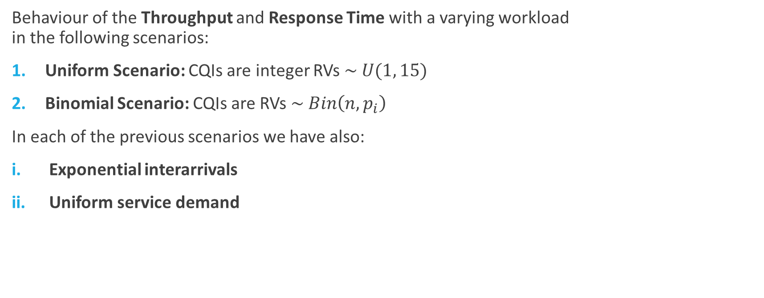
Cellular Network: Case of studies
Behaviour of the Throughput and Response Time with a varying workload in the following scenarios:
Uniform Scenario: CQIs are integer RVs $\sim U(1, 15)$
Binomial Scenario: CQIs are RVs $\sim Bin\left(n, p_{i}\right)$
In each of the previous scenarios we have also:
Exponential interarrivals
Uniform service demand
Antonio Le Caldare, Vincenzo Consales, Vincent della Corte - PECSN
4

Slide 5

Cellular Network: Simulation Parameters
Here a list of simulation parameters:
#RBs = 25
#Mobile Stations = 10
#RNG = 30
${RBsize}_{max}$= 93
${packetsize}_{max}$= 75
$T_{slot}$ = 1ms
#Repetitions = 10
Simulation Time = 60s
Warm-up period = 0.5s
Antonio Le Caldare, Vincenzo Consales, Vincent della Corte - PECSN
5

Slide 6
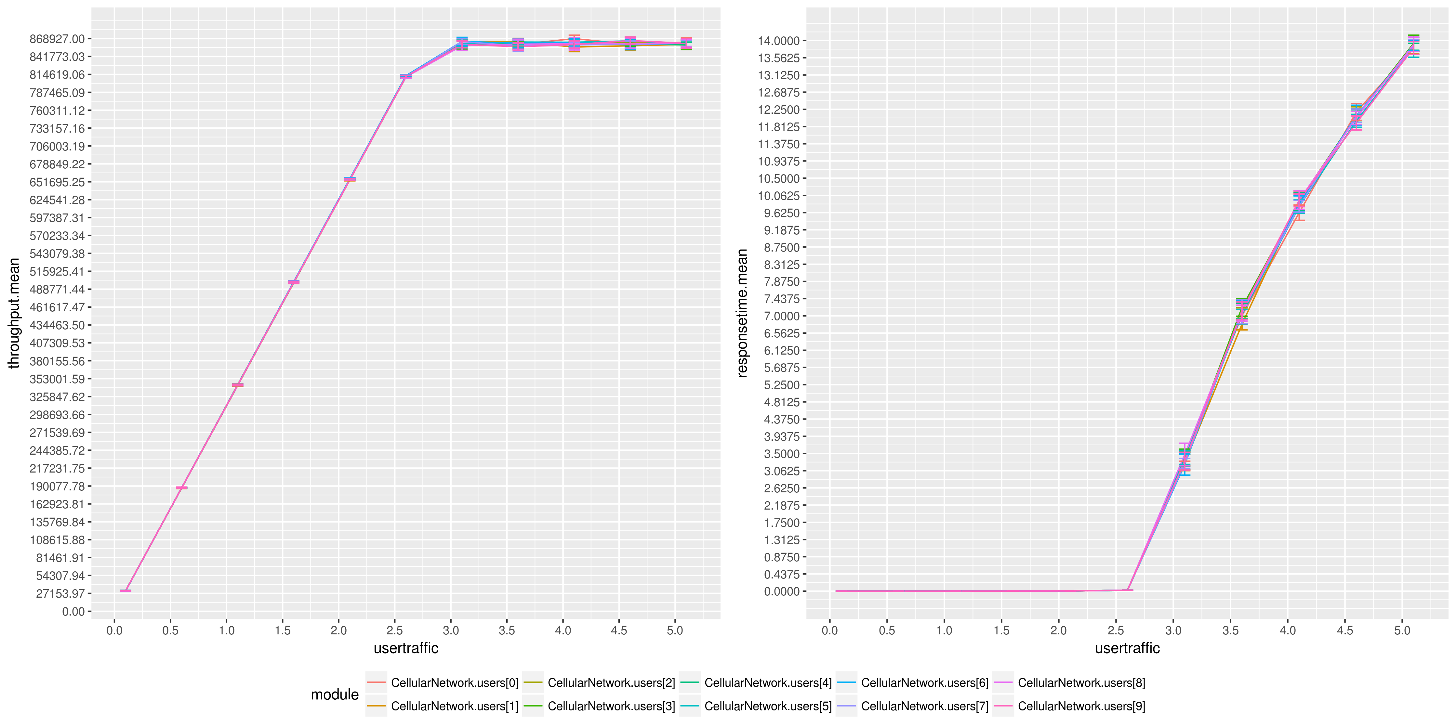

Simulation Results: Uniform Scenario (1/2)
Round-Robin Frame Fill Scheduler
Every client has the same saturation point (${\text{λ}}_{sat}$ = 3.1)
Every client has the same response time for $\text{0}\text{ < }\text{λ} \text{<}{ \text{λ}}_{sat}$
${ \text{λ}}_{sat}=\frac{{ \text{λ}}_{max}}{10}$
${ \text{λ}}_{max}=\frac{\#RB ×{RBsize}_{max}}{1000 ×T_{slot} × {packetsize}_{max}}$
$E\left[{th}_{antenna}\right]$ is expected to be $\frac{\#RB ×E[{rbsize}_{i}]}{1/T_{slot}}=8.12 Mbps$ but
Requirements on frame filling make that analytical model wrong
Antonio Le Caldare, Vincenzo Consales, Vincent della Corte - PECSN
6

Slide 7
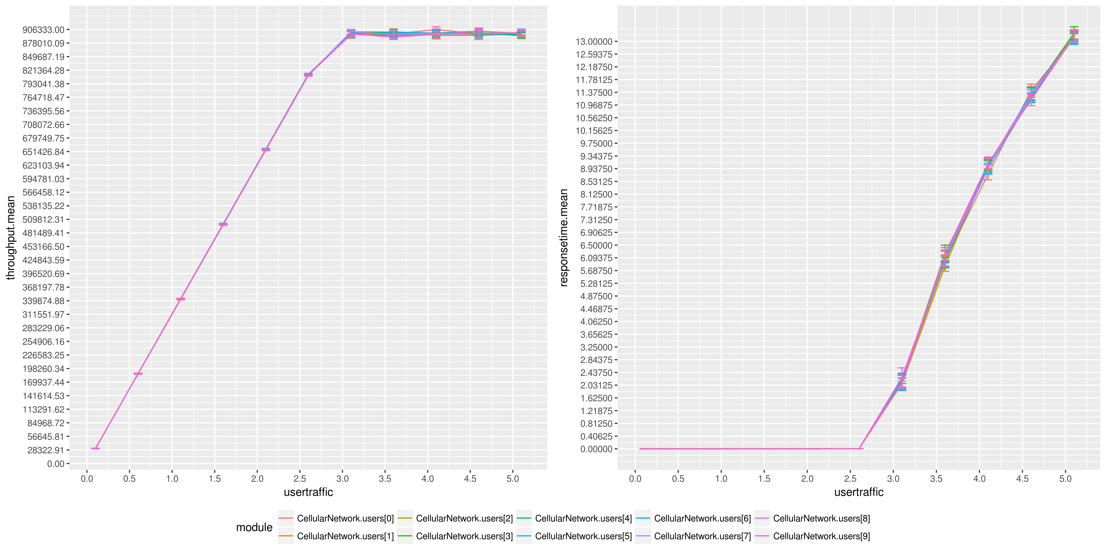
Simulation Results: Uniform Scenario (2/2)
Round-Robin Best CQI based Frame Fill Scheduler
Saturation point as previous
Higher Throughput because it fills the residual space in the frame with packets of the user with highest CQI
Smaller Response Time
Antonio Le Caldare, Vincenzo Consales, Vincent della Corte - PECSN
7

Slide 8
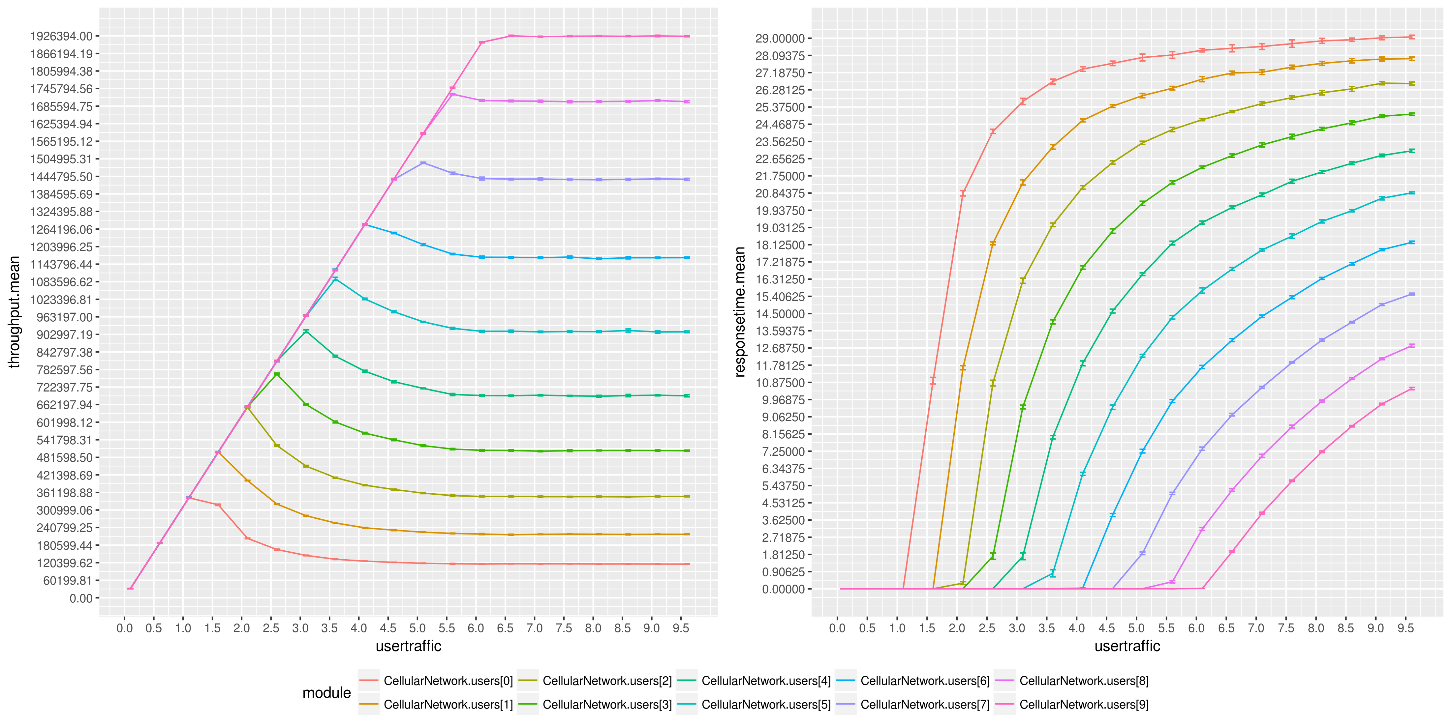
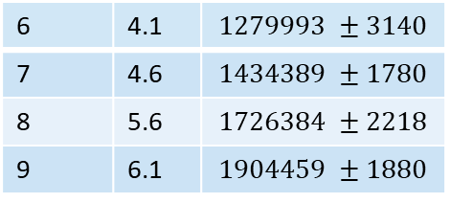
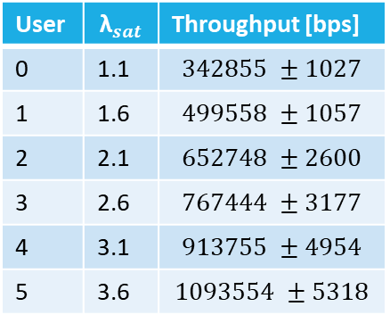
Simulation Results: Binomial Scenario (1/2)
Round-Robin Frame Fill Scheduler
Each user has its own saturation point depending on its mean CQI
Peaks before saturation due to requirements on frame filling
User | $${\text{λ}}_{sat}$$ | Throughput [bps]
0 | 1.1 | $$342855 ±1027$$
1 | 1.6 | $$499558 ±1057$$
2 | 2.1 | $$652748 ±2600$$
3 | 2.6 | $$767444 ±3177$$
4 | 3.1 | $$913755 ±4954$$
5 | 3.6 | $$1093554 ±5318$$
6 | 4.1 | $$1279993 ±3140$$
7 | 4.6 | $$1434389 ±1780$$
8 | 5.6 | $$1726384 ±2218$$
9 | 6.1 | $$1904459 ±1880$$
Antonio Le Caldare, Vincenzo Consales, Vincent della Corte - PECSN
8

Slide 9
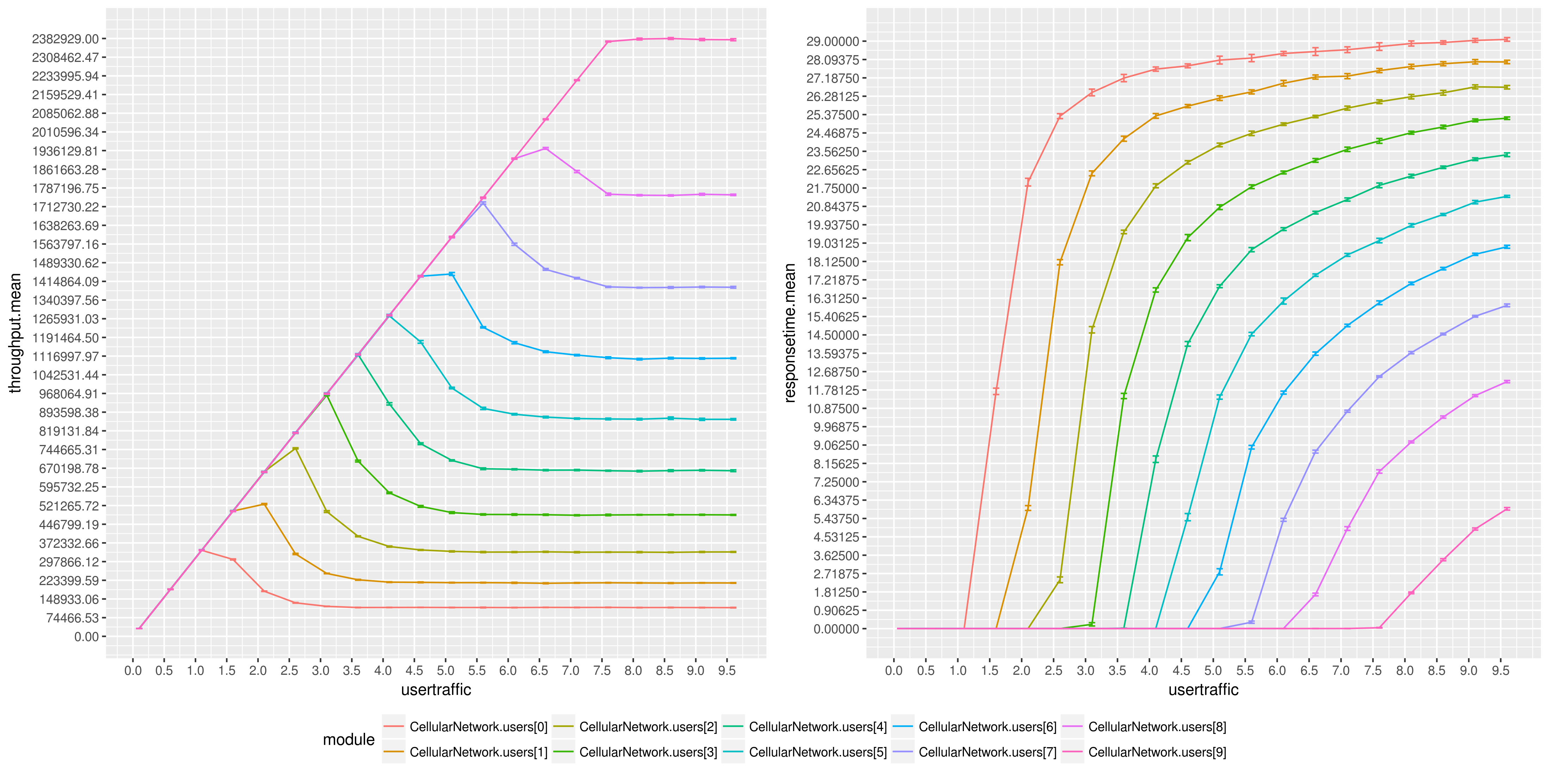
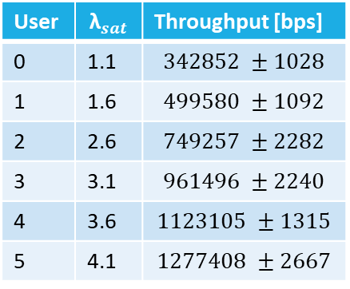
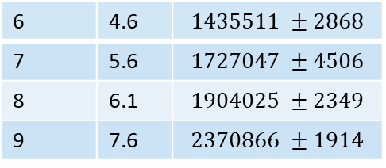
Simulation Results: Binomial Scenario (2/2)
Round-Robin Best CQI based Frame Fill Scheduler
Users 1-8 get a shorter tail before saturation that means an higher value around the peak
They ‘steal’ RBs to ones with lower CQI
User 0 can’t
User 9 has nobody that ‘steals’ its RBs
User | $${\text{λ}}_{sat}$$ | Throughput [bps]
0 | 1.1 | $$342852 ±1028$$
1 | 1.6 | $$499580 ±1092$$
2 | 2.6 | $$749257 ±2282$$
3 | 3.1 | $$961496 ±2240$$
4 | 3.6 | $$1123105 ±1315$$
5 | 4.1 | $$1277408 ±2667$$
6 | 4.6 | $$1435511 ±2868$$
7 | 5.6 | $$1727047 ±4506$$
8 | 6.1 | $$1904025 ±2349$$
9 | 7.6 | $$2370866 ±1914$$
Antonio Le Caldare, Vincenzo Consales, Vincent della Corte - PECSN
9

Slide 10
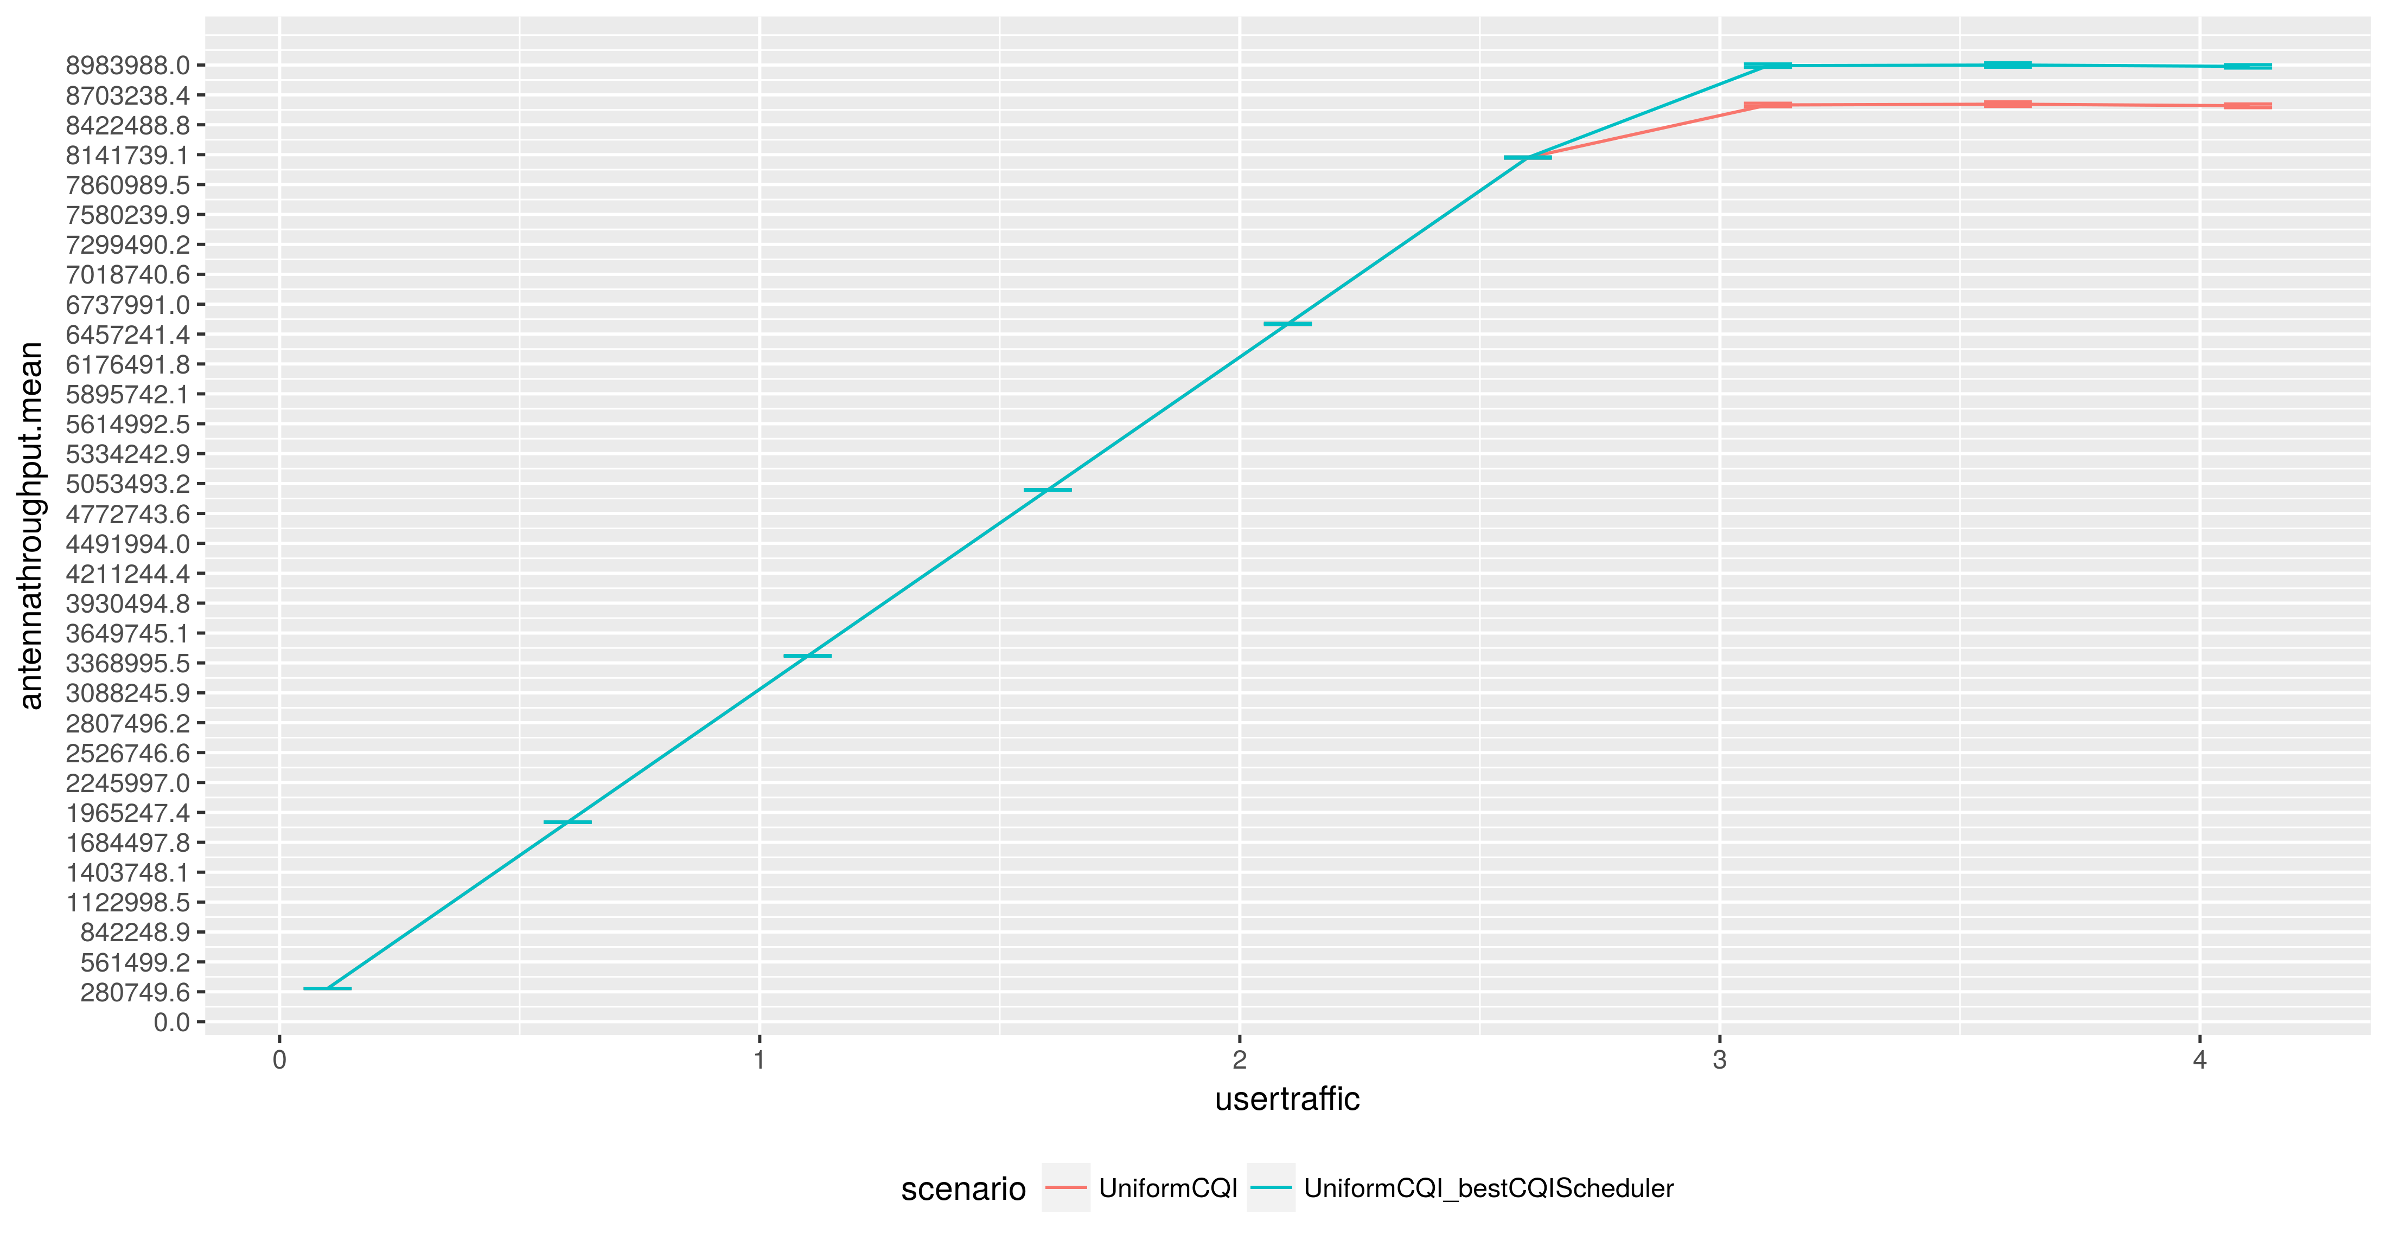
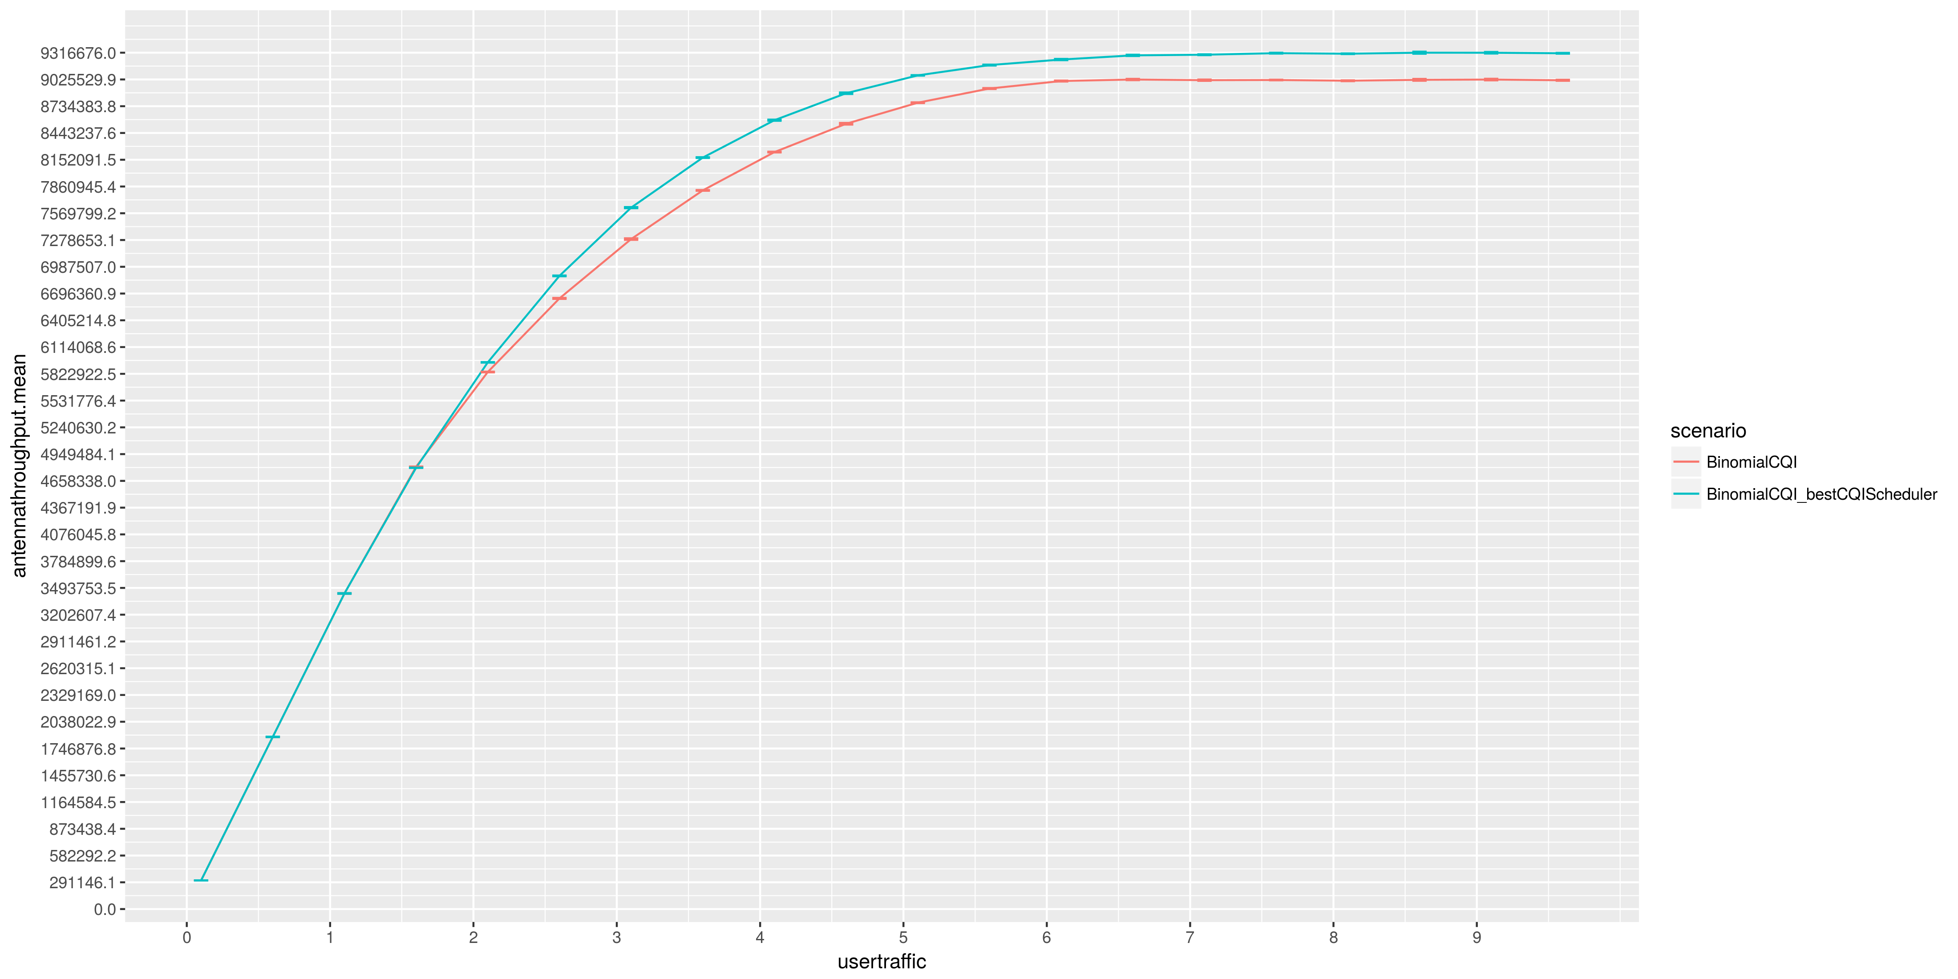
Conclusions (1/3)
Best-CQI based frame scheduler provides higher total throughput than Fair one in both scenarios
Antonio Le Caldare, Vincenzo Consales, Vincent della Corte - PECSN
10

Slide 11
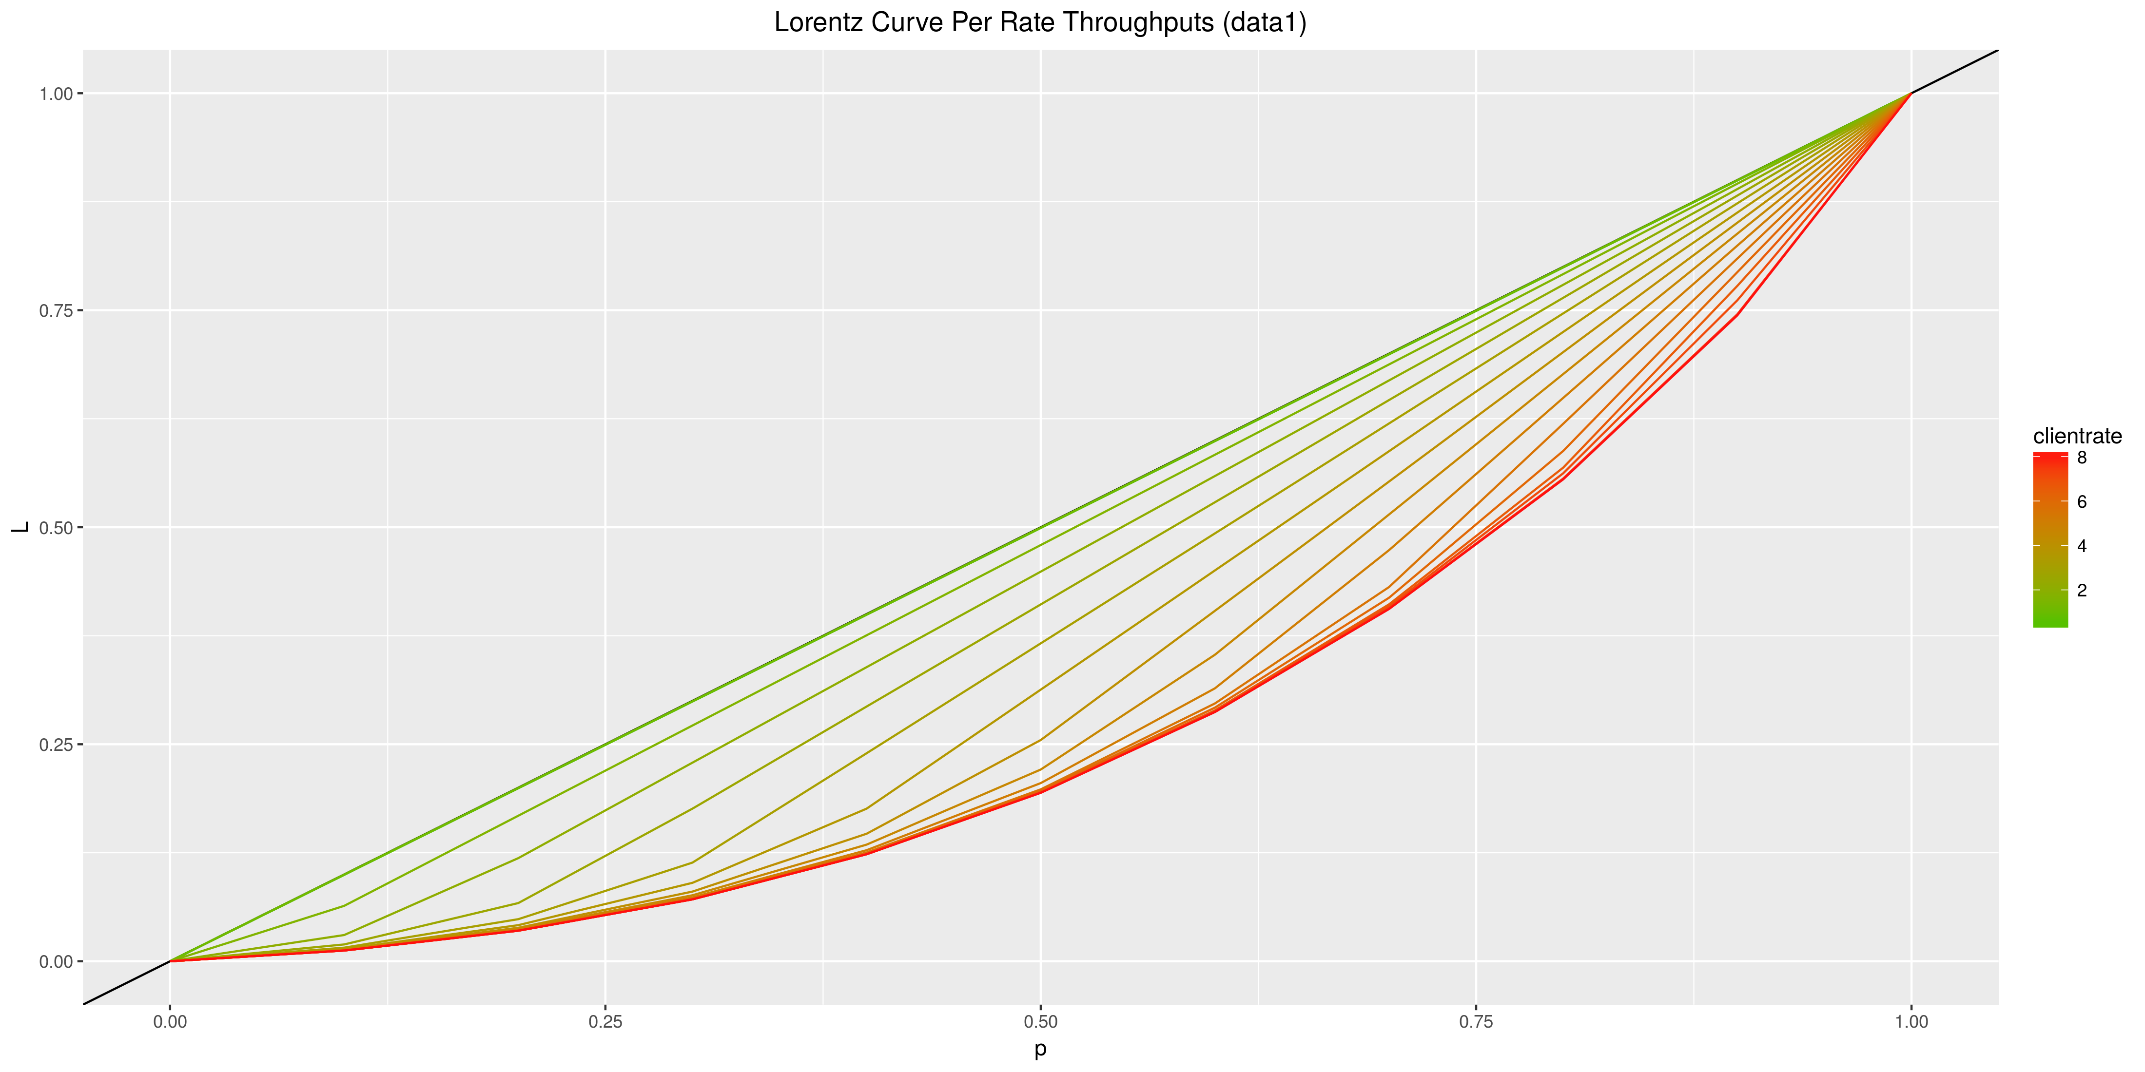

Conclusions (2/3)
However it is also true that it is less fair and this can be shown in Binomial scenario
When $\text{λ}$ is low there is low unfairness since no one has reached saturation yet but as $\text{λ}$ grows user 9 uses all extra RBs
Antonio Le Caldare, Vincenzo Consales, Vincent della Corte - PECSN
11

Slide 12
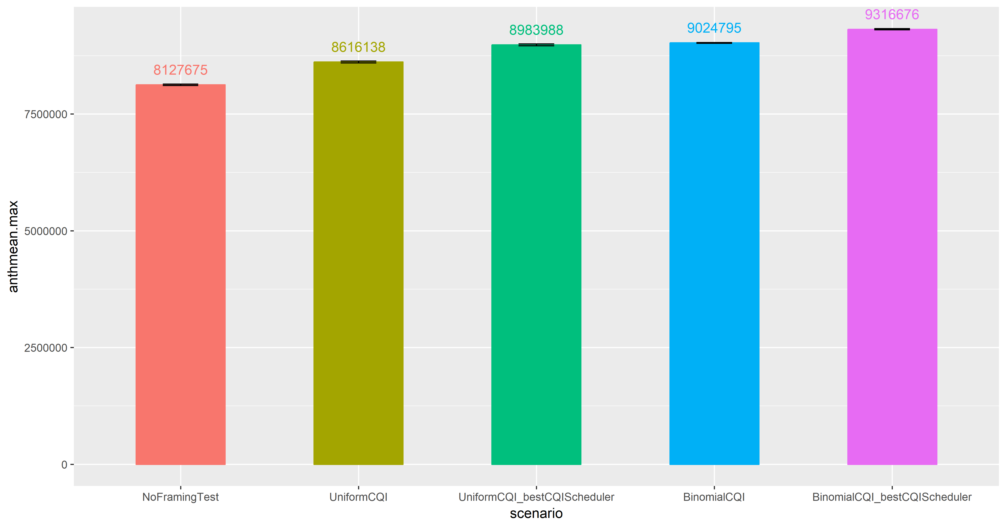
Conclusions (3/3)
Frame filling policies had big impact on performances and fairness. However it is difficult to build an analytical model because of framing and requirements imposed by the model
Antonio Le Caldare, Vincenzo Consales, Vincent della Corte - PECSN
12

